Slide 1
Measure intensities

Slide 2
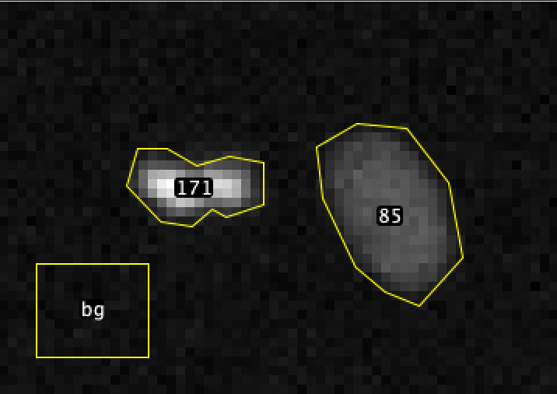
object_id | mean | num_pixels | mean_bg | mean_corr | sum_corr
85 | 134.89 | 303 | 100.29 | 34.60 | 10484.12
171 | 151.20 | 185 | 100.29 | 51.01 | 9438.34
xy_16bit__h2b.tif

Slide 3
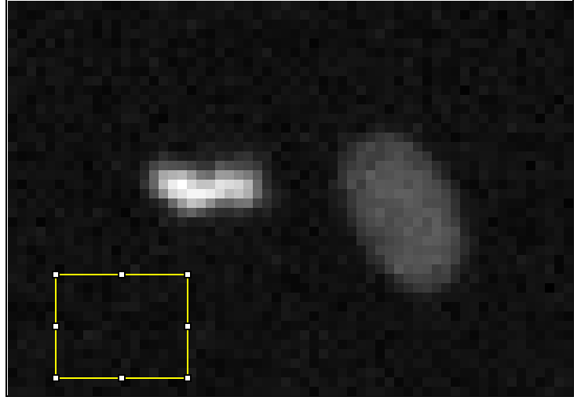
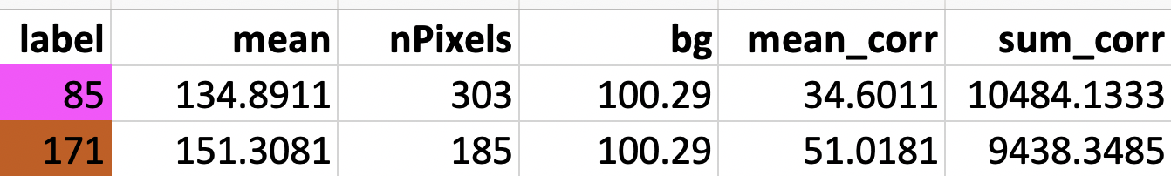
bg
xy_16bit__h2b.tif

Slide 4
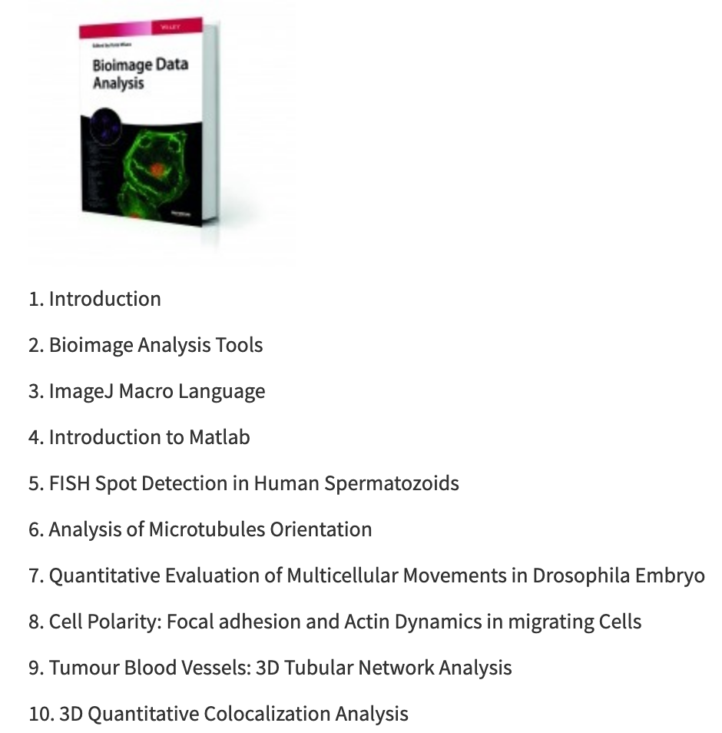
Intensity measurements are very challenging!

Slide 5
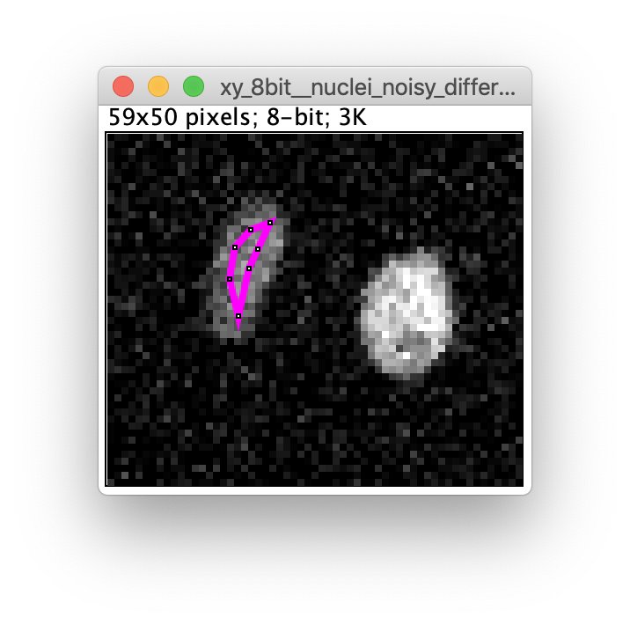
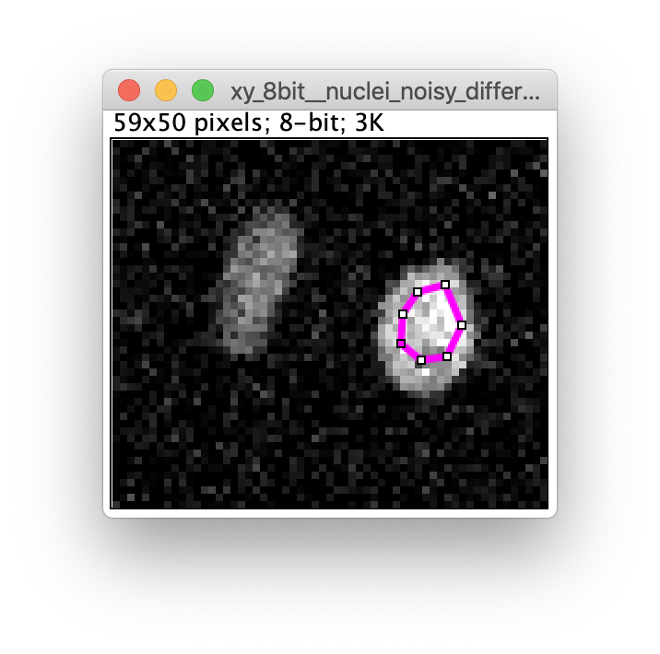
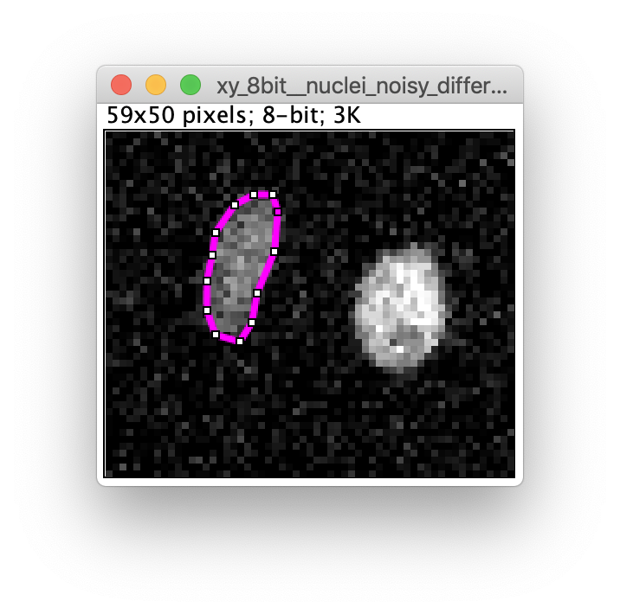
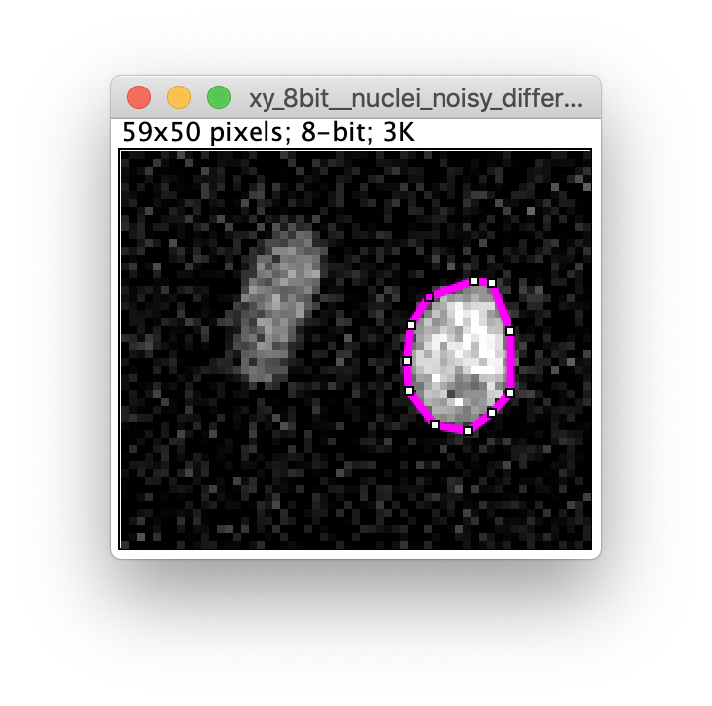

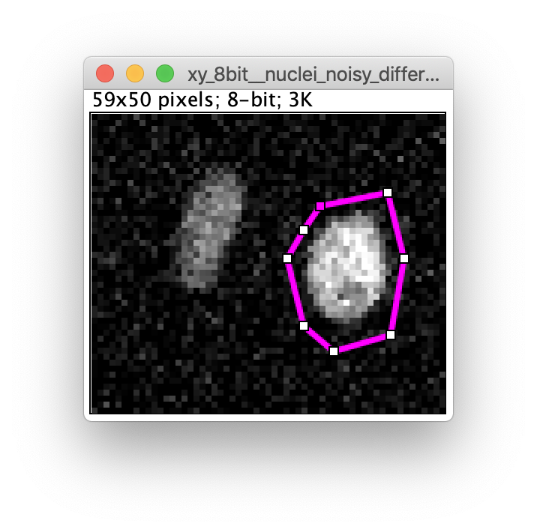
Where to measure?
What to measure?
Mean, Sum, Min, Max, Median, …

Slide 6
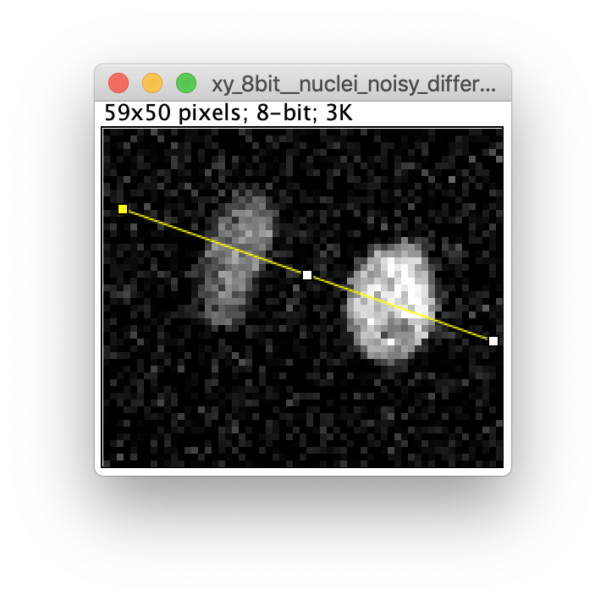
How to compare intensities and how to take into account „background“?
110 – 80 = 30
110 / 80 = 1.375
( 110 – 55 ) / ( 80 – 55 ) = 55 / 25 = 2.2

Slide 7
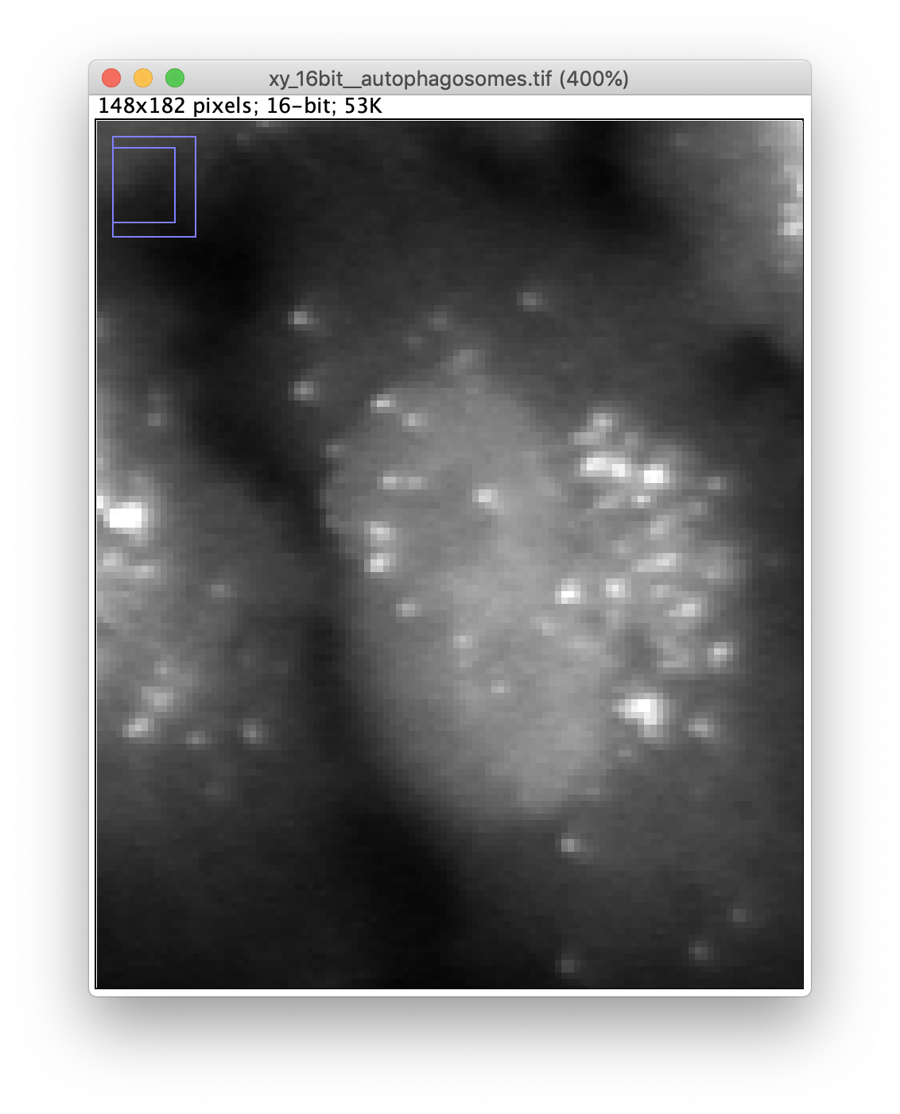
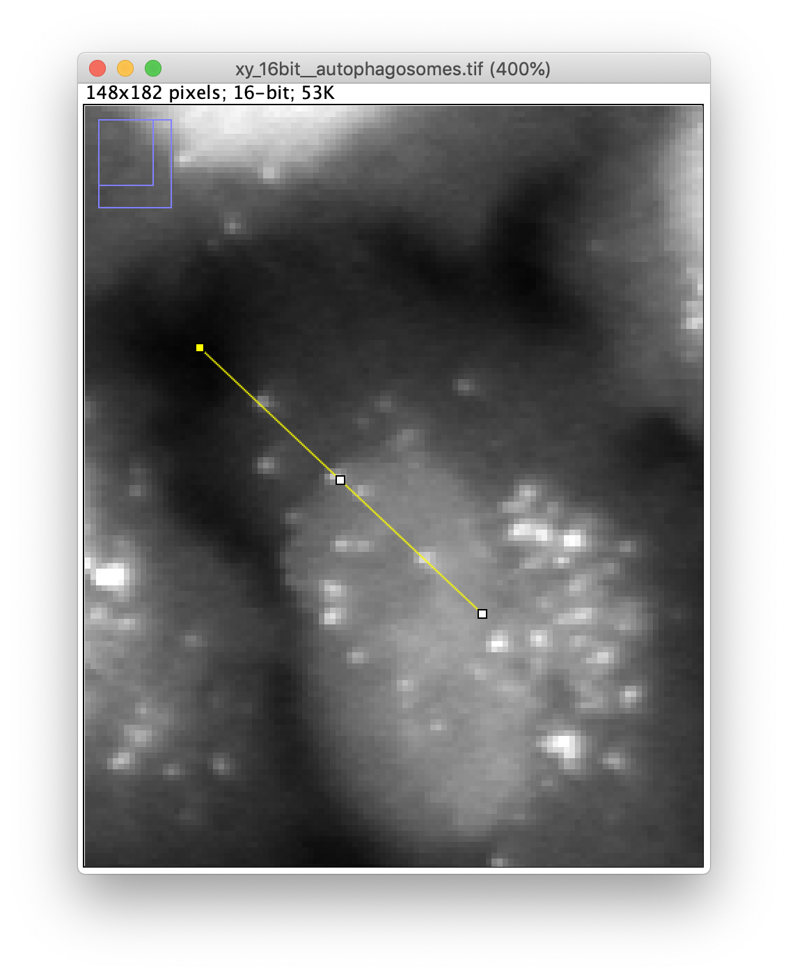
How to compare intensities and how to take into account „background“?

Slide 8
Intensity measurements
There are many decisicion to be taken
Many ways to take the wrong decisions
The right decisions depend on the combination of
Sample
Sample preparation (staining)
Microscopy (e.g. confocal vs widefield)
Biological question
In case of doubt: consult a good and experienced bioimage analyst!

